Slide 1
An introduction to digital adherence technologies (DATs)
An introductory presentation on DATs for stakeholders.

Slide 2
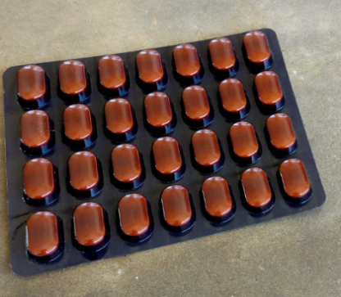
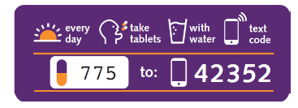
Outline
Introduction
  How the medication label works
  Potential benefits
blah
  Use and distribute
  Features
blah
  Overview
  Registering a new patient

Slide 3
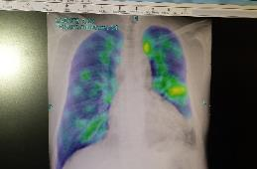
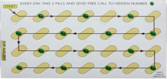
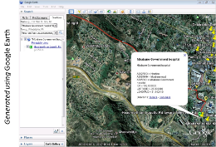
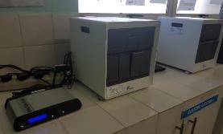
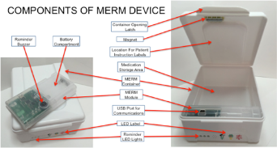
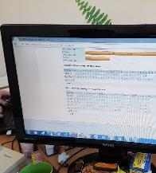
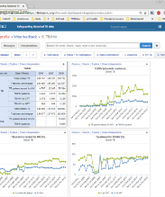
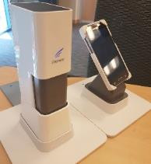
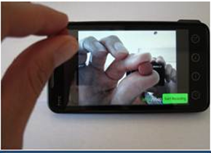
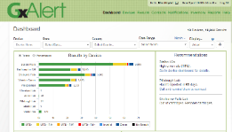
Examples of Digital Health Solutions
Diagnosis
Care & treatment support
Surveillance & monitoring

Slide 4
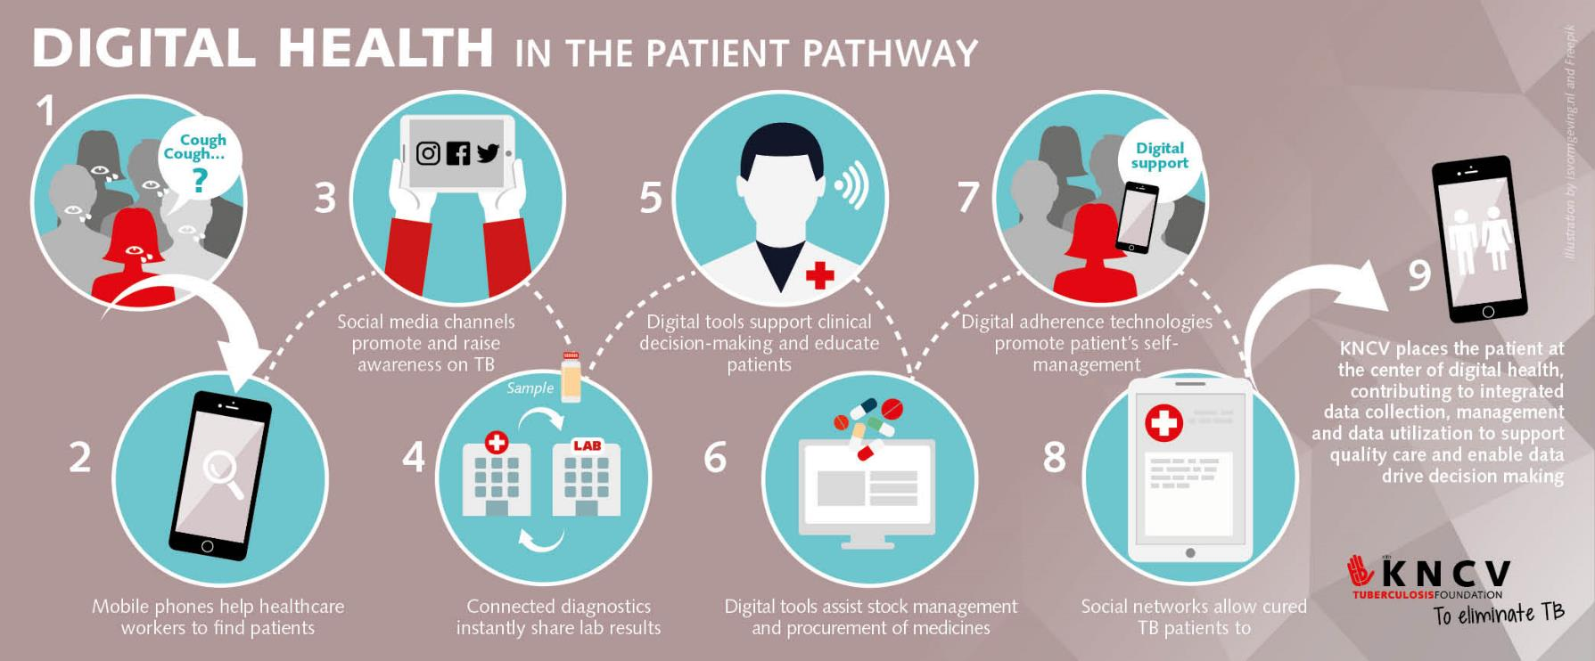

Slide 5
TB Medication and Adherence
What are the challenges?

Slide 6
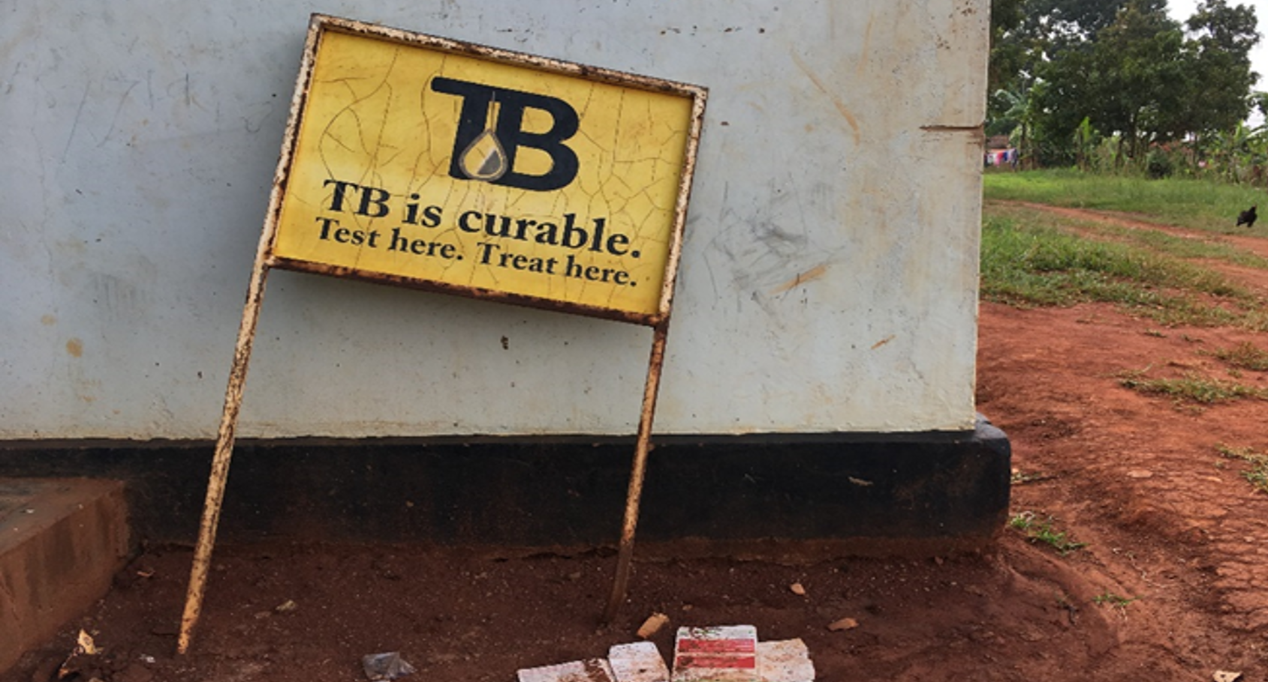
Notes:
TB infects about 10 million people a year and it kills more people than any other infection including HIV/AIDS.
Most cases occur in countries where accessing healthcare is a challenge.
TB as an airborne disease -> patient without proper treatment easily infect up to 10-15 others
TB is curable!
Medication adherence (making sure that patients take their medication as prescribed) is particularly problematic for tuberculosis patients

Slide 7
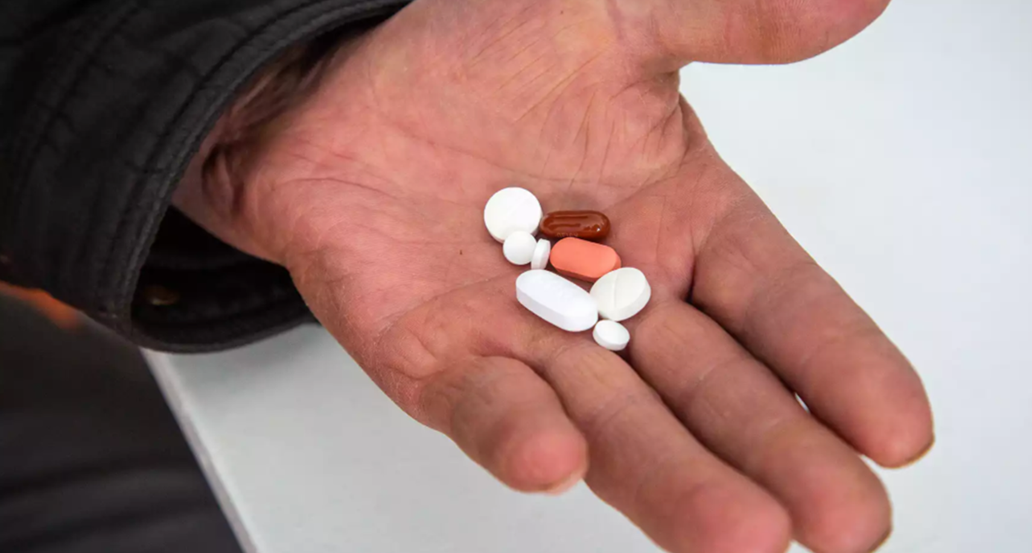
Notes:
These pills have the power to improve health and prolong a live. But only if and when they are taken by the patient
We know that it is very hard to take pills and that there are many reasons for medication non-adherence
Log treatment, side effects, stigma, etc

Slide 8
Notes:
And even for drug sensitive TB patients, missing doses of medication during tuberculosis treatment has serious negative effects
Patients are more likely to stop their TB treatment
Patients can develop resistance to anti TB drugs
Patients are more likely to get TB again

Slide 9
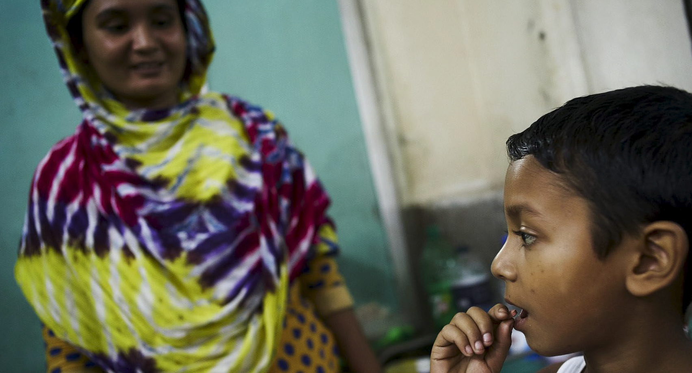
Notes:
To prevent medication non-adherence and support patients
About 25 years ago, the WHO endorsed a strategy called Directly Observed Treatment, which includes amongst other things, having the patient’s pill consumption directly observed.

Slide 10
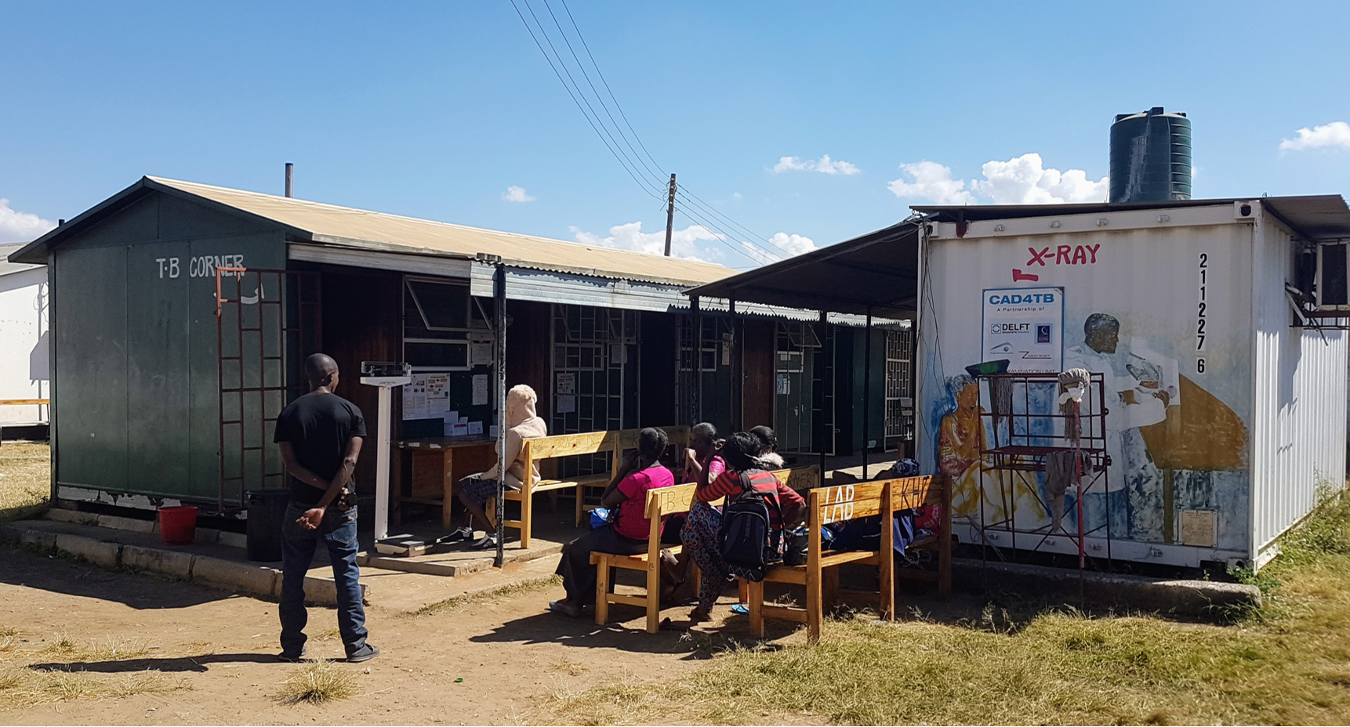
Notes:
Daily at the health facility at special TB corner
Countries have different levels to implement patient support
DOT daily at the facility
DOT at patient home
Self administration with or without a treatment supporter

Slide 11
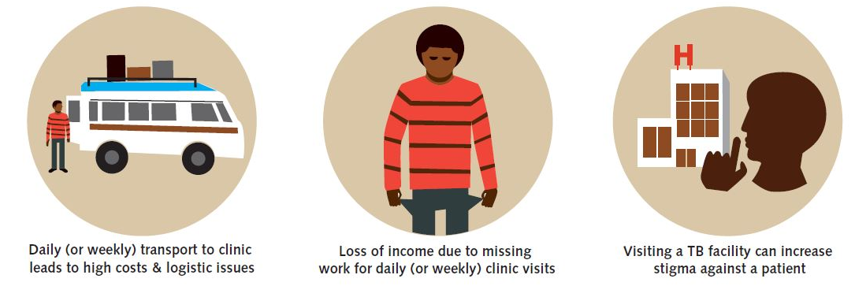
Patient Challenges
Notes:
For the patient this approach has several challenges
It is a huge burden and inconvenience to go daily (or weekly) to the clinic that lead to high costs & logistic issues
Loss of income due to missing work for daily (or weekly) clinic visits
Visiting a TB facility can increase stigma against a patient

Slide 12
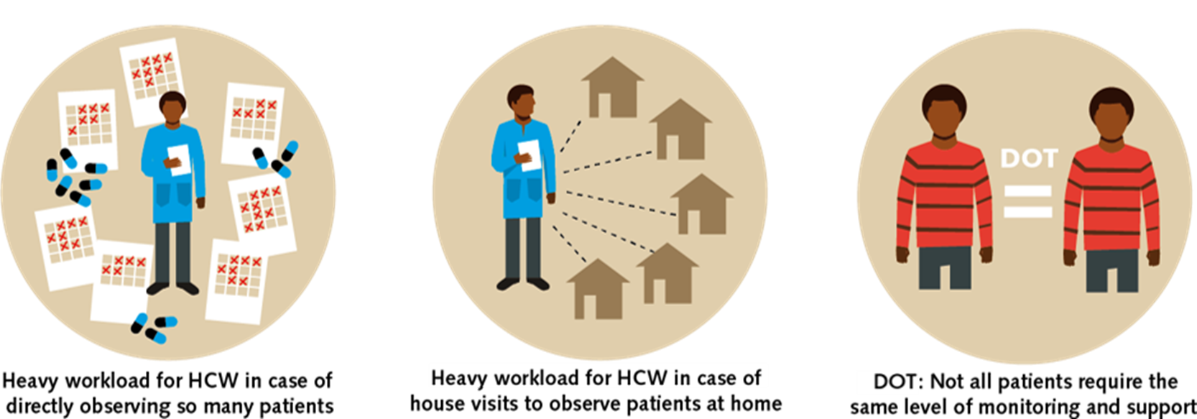
Healthcare Provider Challenges
Notes:
From the health provider perspective
Heavy workload for HCW in case of directly observing so many patients
Heavy workload for HCV in case of house visits to observe patients at home
Not all patients require the same level of monitoring and support
→Countries different ways of ‘supporting and observing’ patients

Slide 13
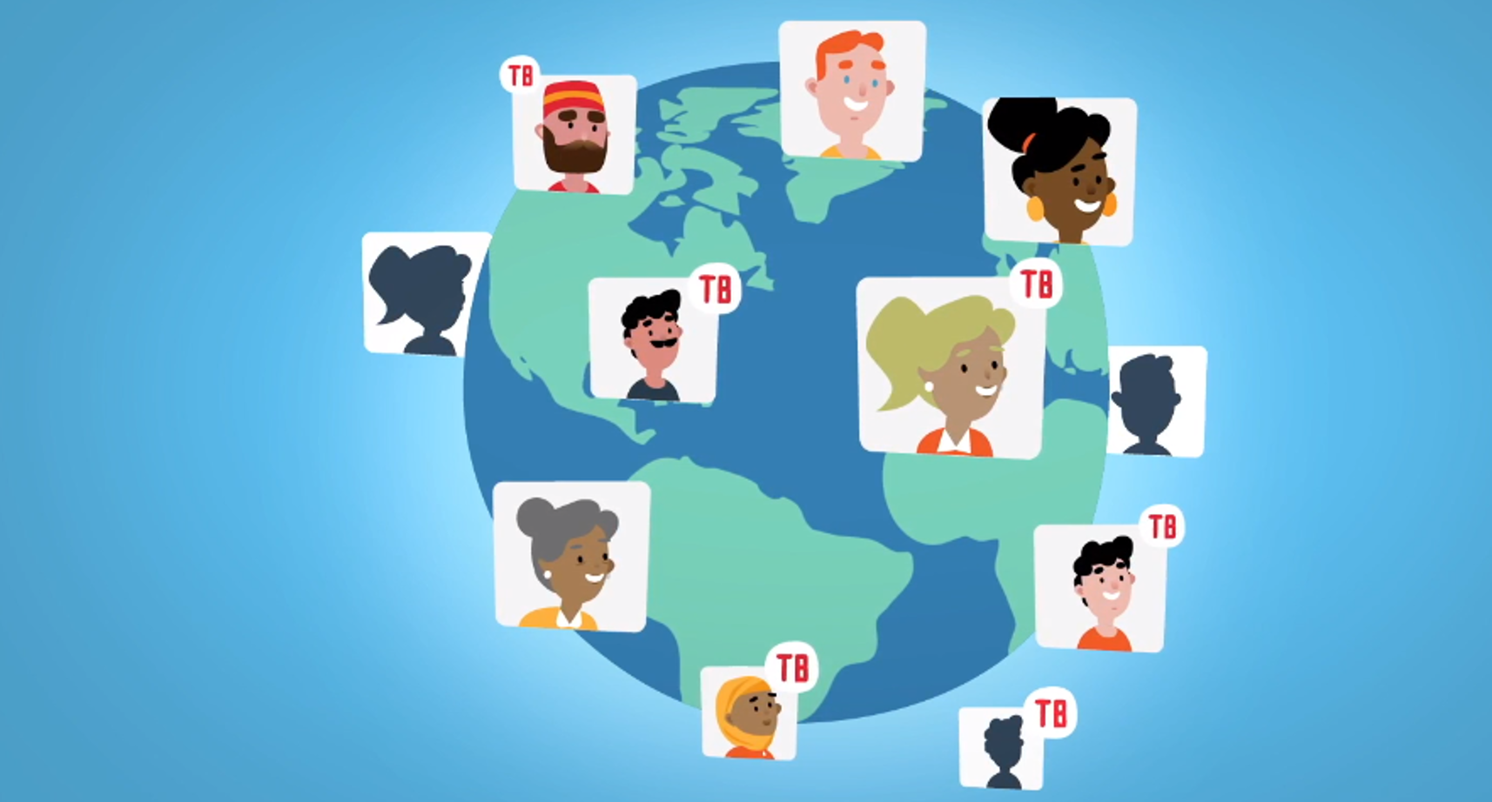
Notes:
While the DOT approach has advanced global decline in TB incidence
We need a better way to support the 10 million patients who will develop TB this year

Slide 14
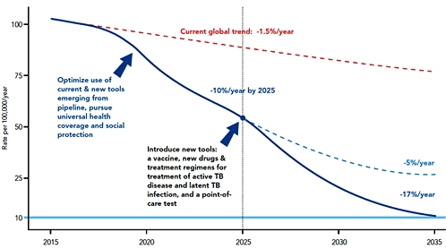
WHO END TB strategy global TB burden
Notes:
ENDTB strategy, make use of technology, available systems and data

Slide 15
Notes:
But how are we going to help those millions of patients?
With digital technologies that are accessible to our patients.
Digital Technologies / Mobile phone: GAMECHANGER:
In slightly more than 15 years, 72% of the global population has access to phones

Slide 16
Digital technologies to help the fight against tuberculosis

Slide 17

Introduction to a DAT Intervention
Treatment completed!
Technology-enabled care
Does not replace doctor / nurse / healthcare provider / TB focal person
Provides additional support for patients to complete their TB treatment.​
HCW + DAT
Patient

Slide 18
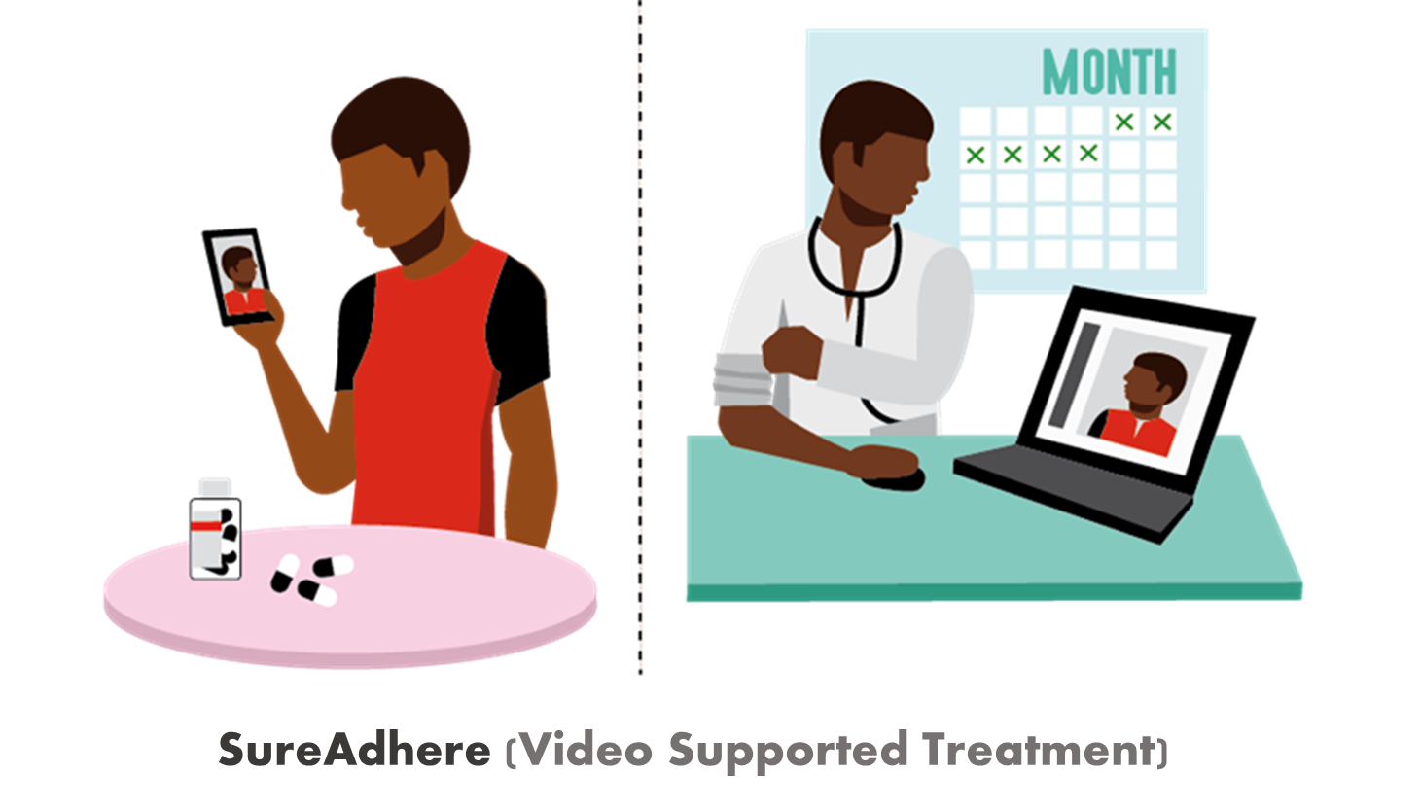
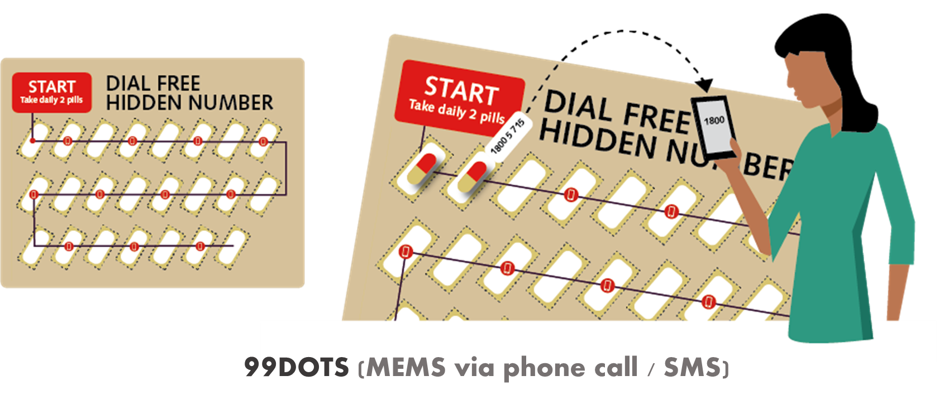
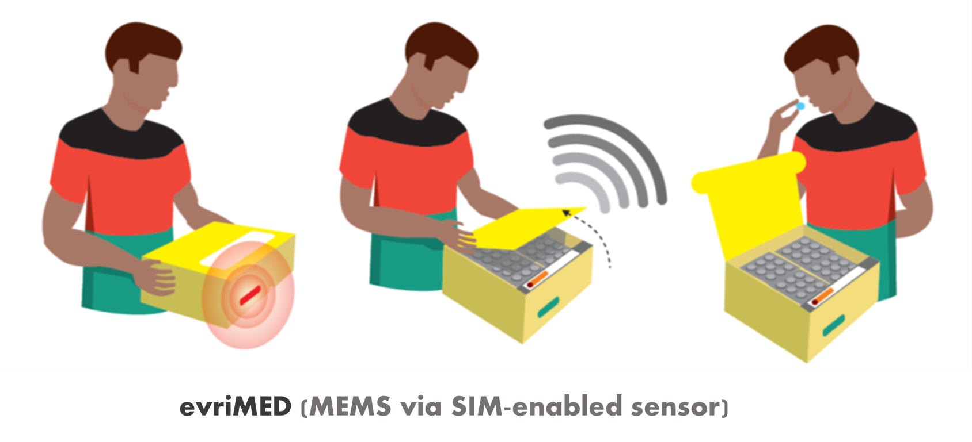
Notes:
The technologies above are gamechangers !
Real-time information whether a patient take medication is phenomenal
Demonstrate each of the different technologies after this presentation

Slide 19
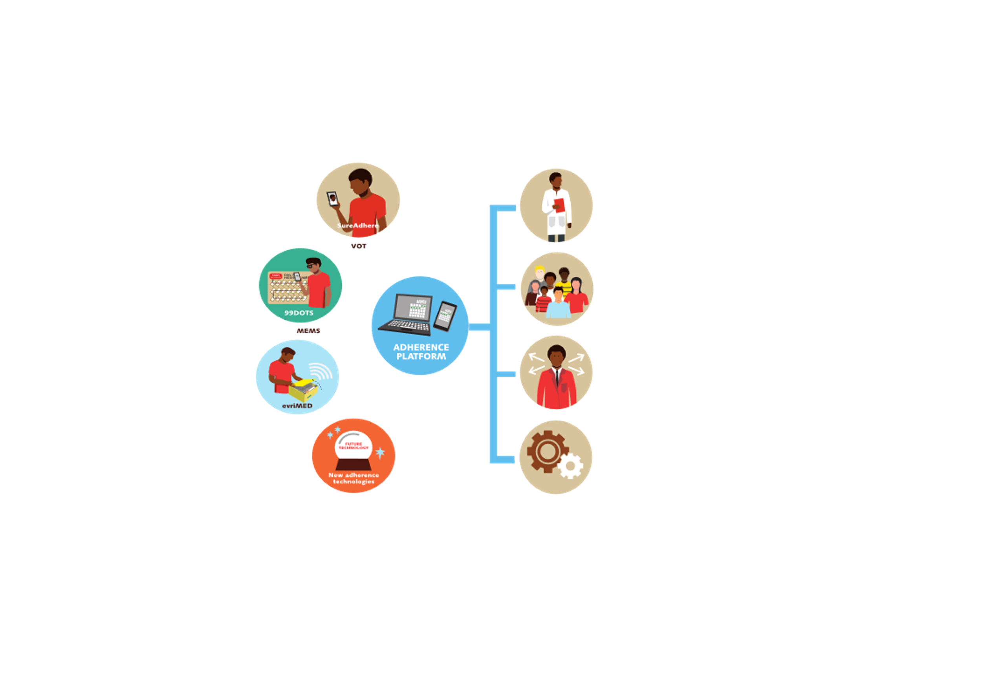
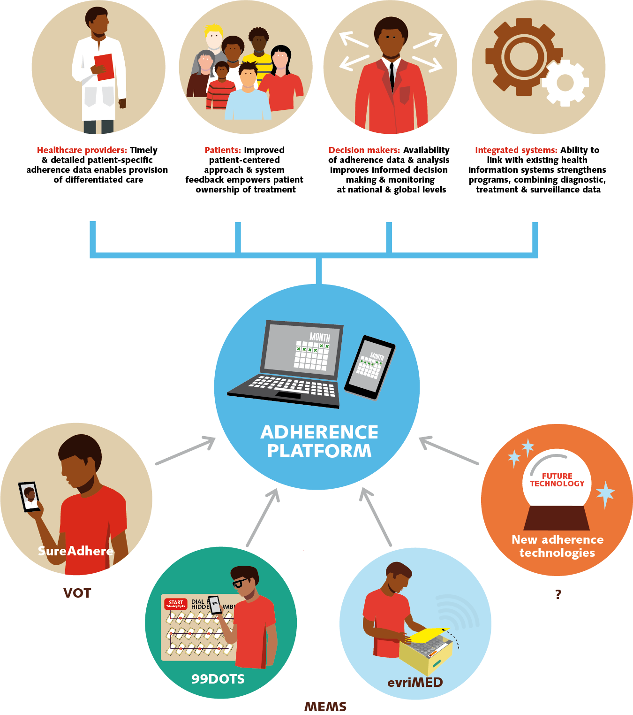
Notes:
Within the project, we propose that all these different technologies can be combined into unified adherence platform
-> Also capable to support new technologies
One view, independent what kind of technology the patient uses
Clear linkages with other systems or processes in country

Slide 20
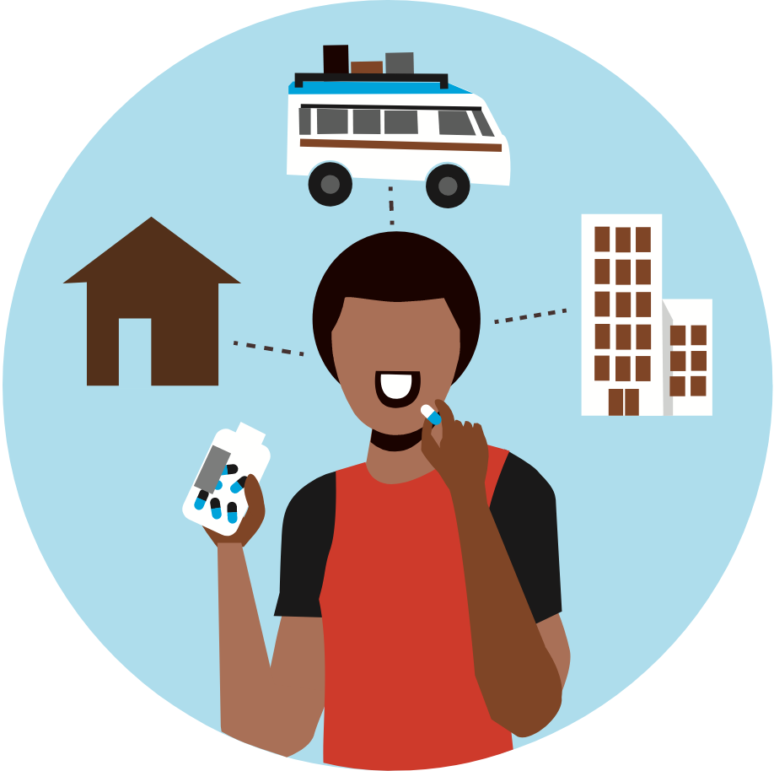
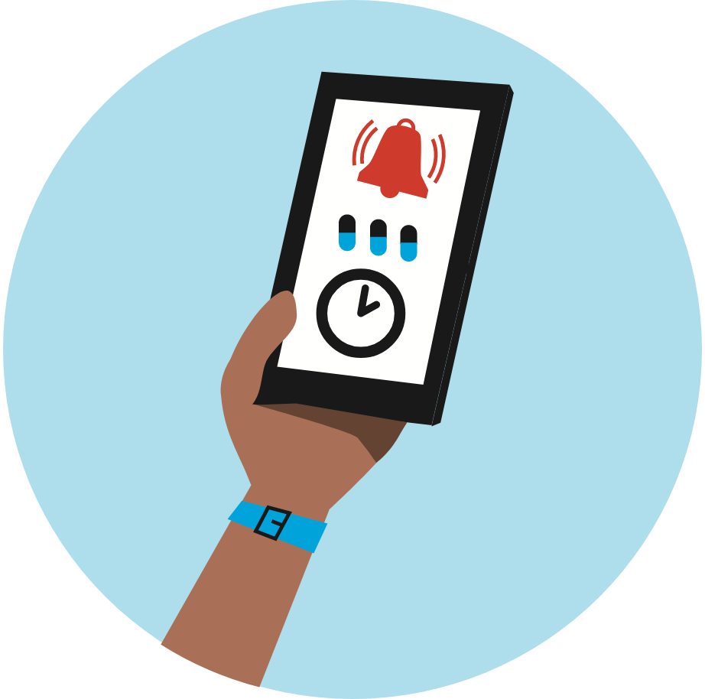
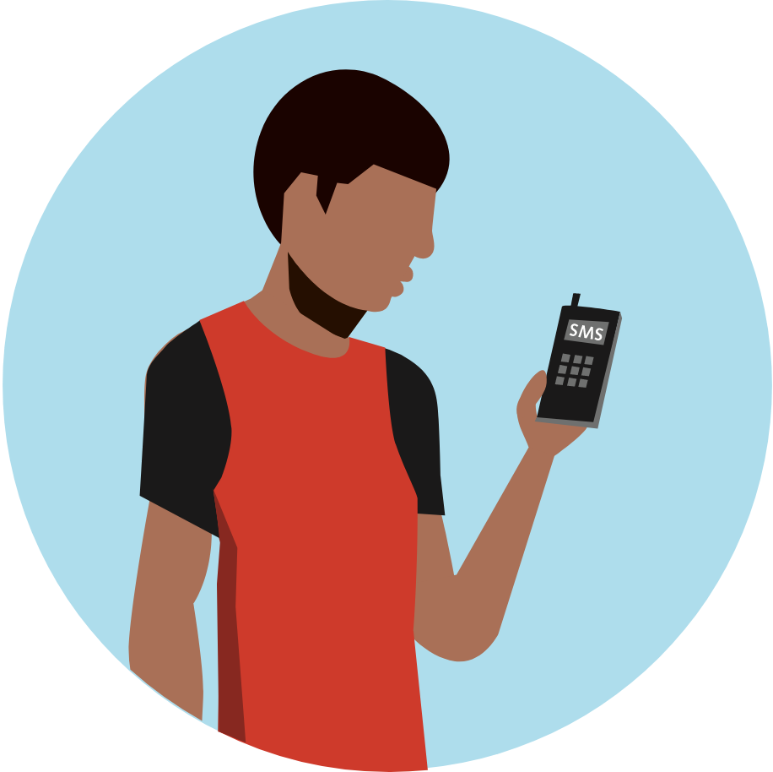
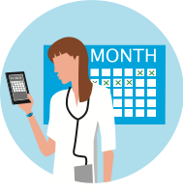
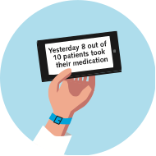

Potential Benefits of DATs
Patient can choose the most suitable time to take medication within their daily routine.
Patient can be prompted by text message to take certain action (e.g., medication reminder.
Patient can receive individualized treatment information or support.
Healthcare providers can access their patient’s real-time medication adherence information through the DAT platform.
The adherence platform can send healthcare providers automated alerts and reports about patients, prompting action.
Helps healthcare providers identify patients who need more support and shape the most suitable treatment response.

Slide 21
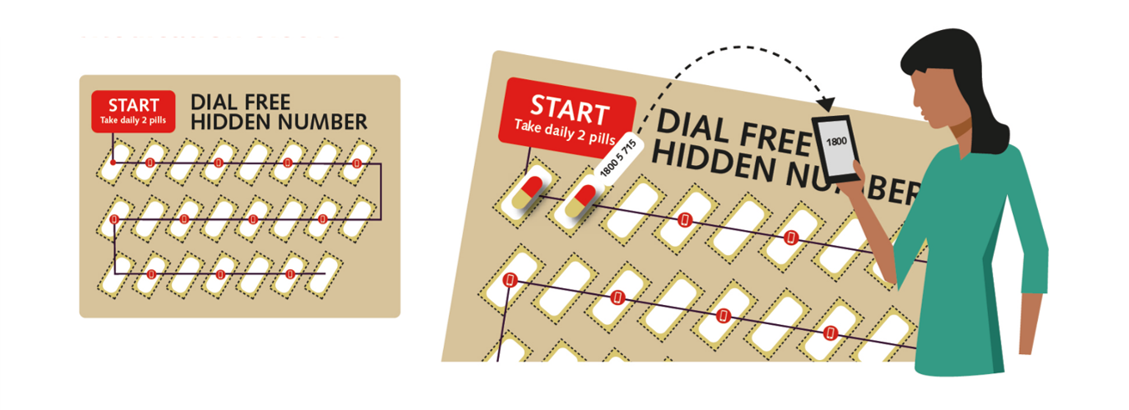
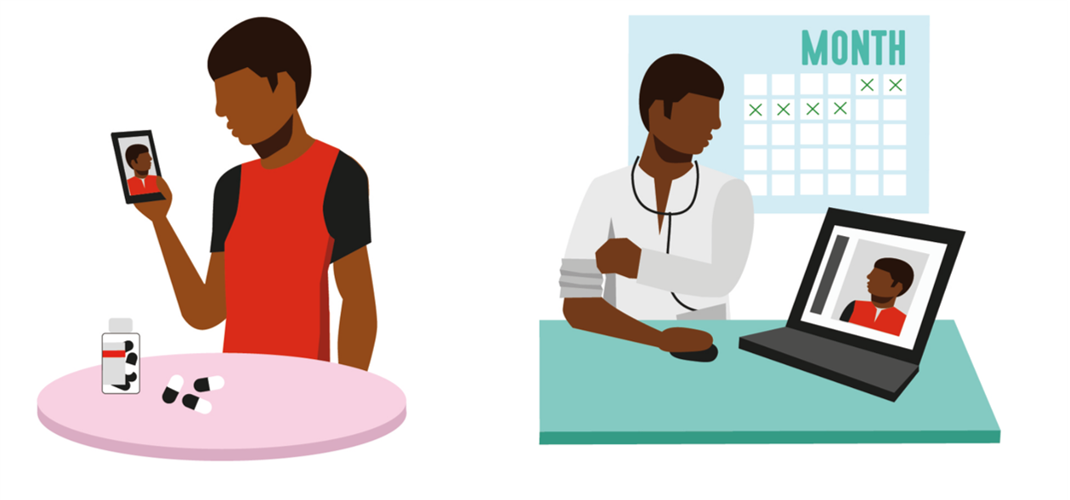
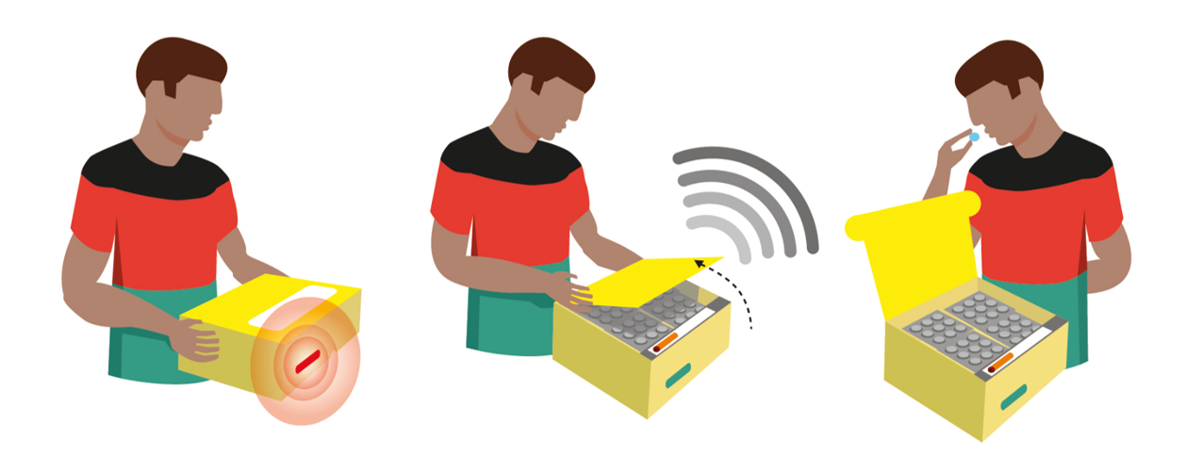
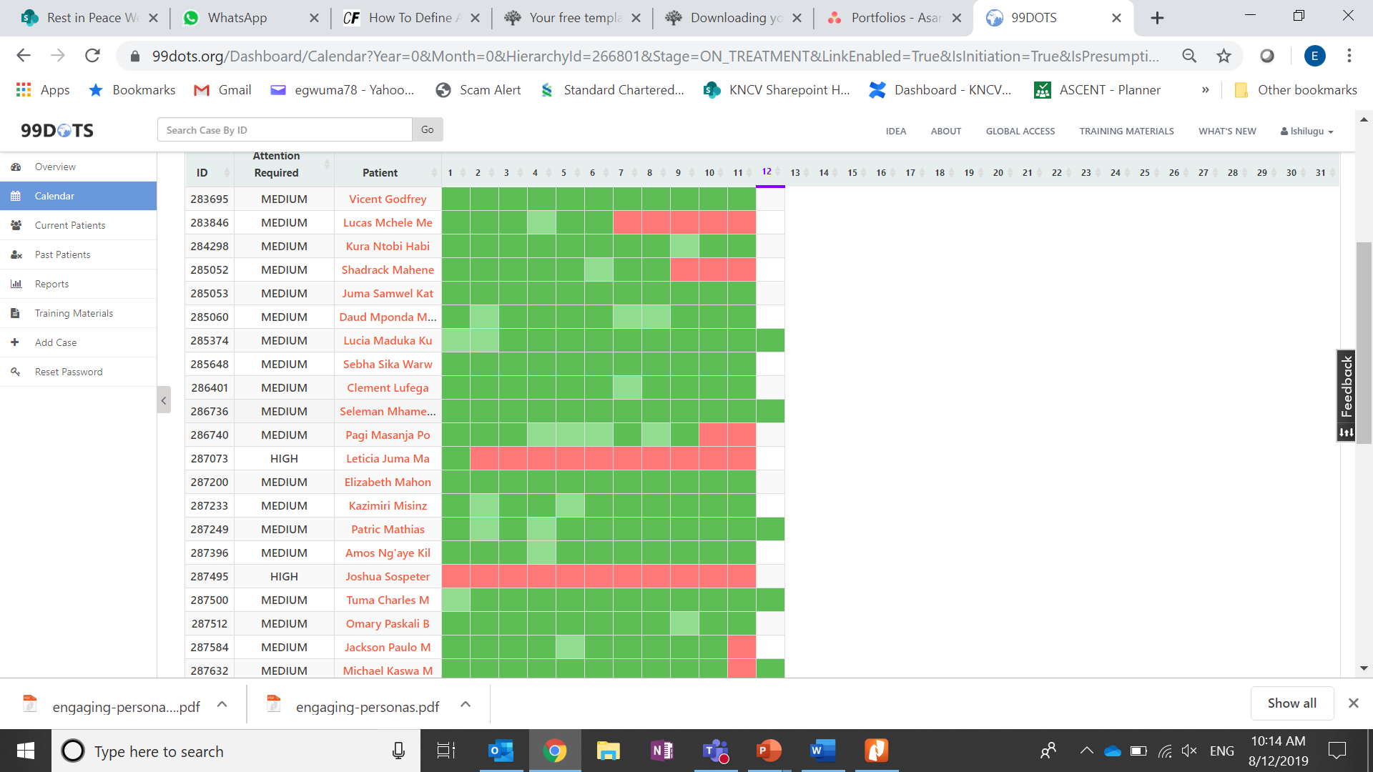
Integrated DATs
Notes:
Health staff at the facility can access the platform via phone or internet to see in real time if their patients are taking their pills.

Slide 22
The Digital Adherence Technologies

Slide 23
Introduction – How 99 DOTS Works?

Slide 24
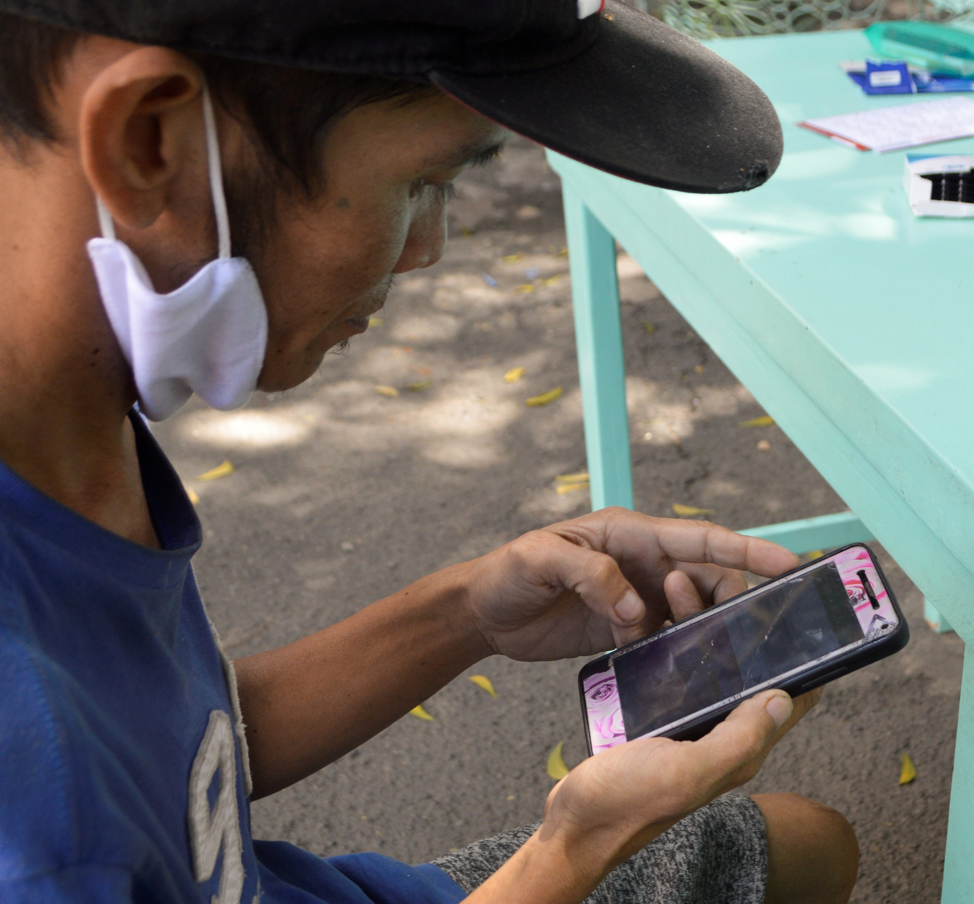
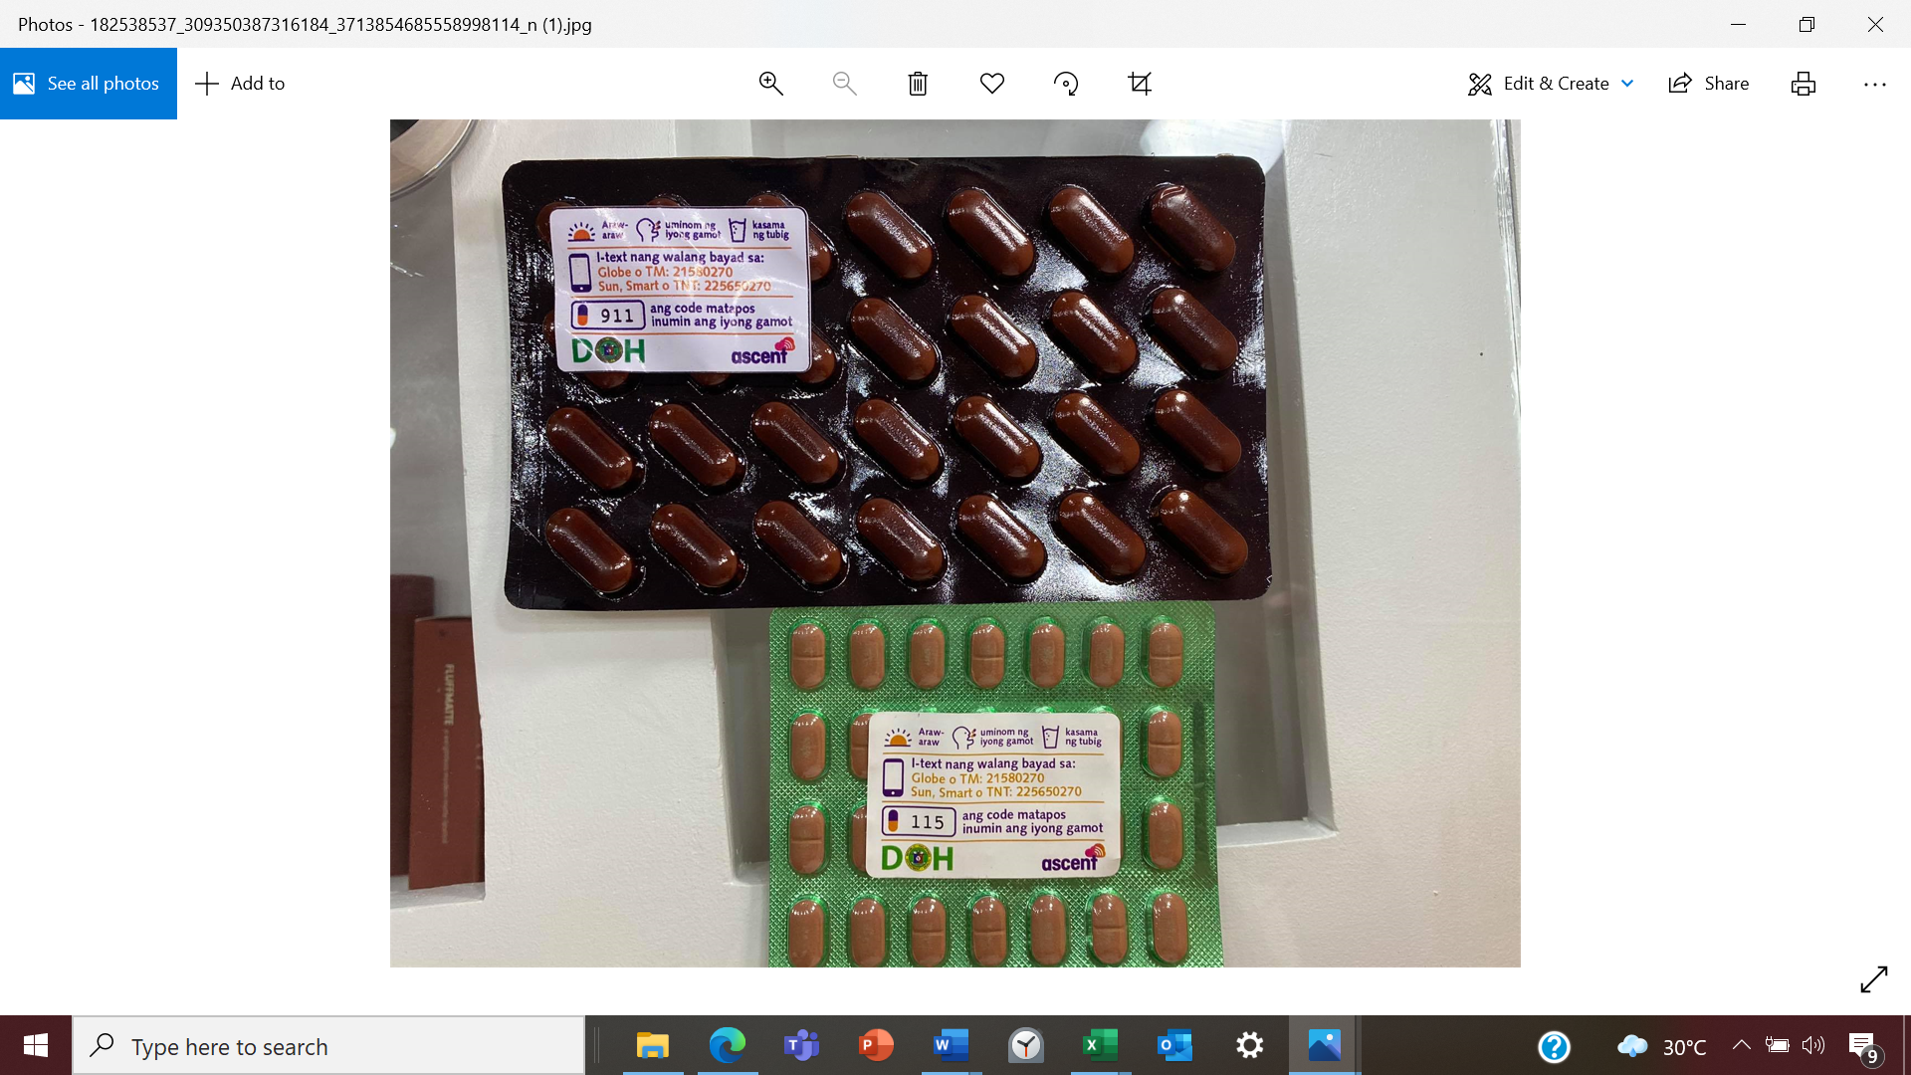
Introduction- Medication labels/stickers
Each label has short instructions for the participants, a 3-digit code, and a toll-free number printed on it.
The 3-digit code is to be sent by SMS to specific number every time the patient takes their medication.
Confirmation of receipt of the 3-digit code enables the healthcare worker to keep track of medication adherence on the platform.
This text gets reflected on the Everwell Hub dashboard and Android mobile app immediately as a taken dose.

Slide 25
How to use the medication label?
Each patient gets their medication in a blister pack with a sticker attached to it.
The predesigned stickers having relevant information on it including random number and free text number to which the random number is sent after taking the daily dose.
Immediately after taking a dose, the patient is expected to text the random number to the number which is designed for this service only and it is free of charge.
This text gets reflected on the Everwell hub immediately as a taken dose.

Slide 26
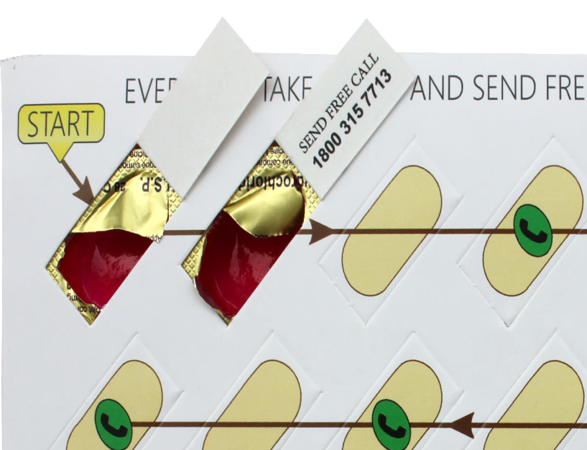
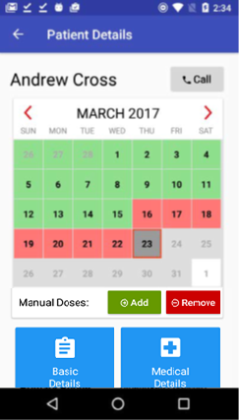
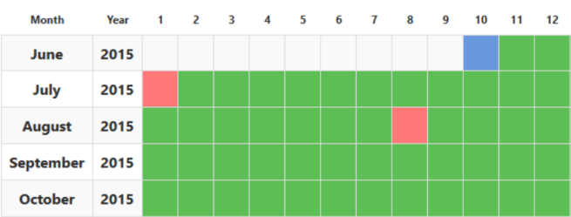
Introduction to medication sleeves
573
Anti-TB drugs are wrapped in custom sleeves which are printed with hidden codes behind the pills
When patients dispense a dose, they reveal a hidden number which they text to a toll-free SMS number (no cost to patient)
This text gets reflected on the Everwell Hub dashboard and Android mobile app immediately as a taken dose

Slide 27
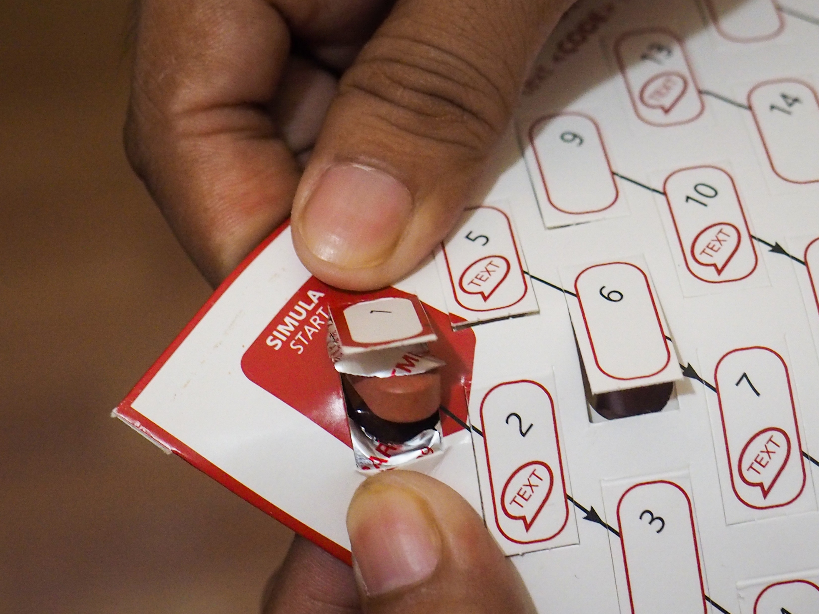
Features
Texts are completely free for patients
A 3-digit code sent from a registered patient number is marked as a dose taken
Numbers are not unique, but appear in an unpredictable sequence – ensures pill-in-hand adherence
When patients send correct code, they will receive a confirmation message
The patient-interaction (sending text to toll-free phone line) immediately show up real time on the Everwell Hub as taken doses

Slide 28
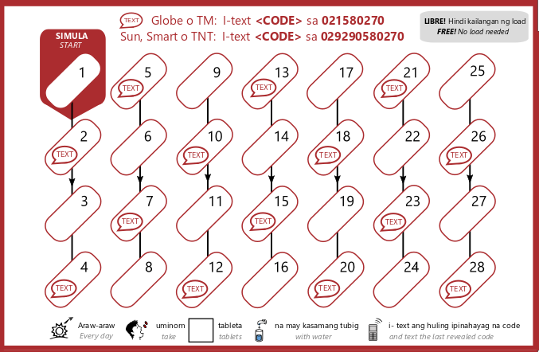
How to provide medication sleeves to patient?
Each patient gets the same sleeve, regardless of weight band
Facility focal person should write number of pills patient should take per day on the sleeve
  Sleeves should not be cut
Every day, a patient pushes out their prescribed number of pills, revealing one, two, or three codes
  Patient should text the last code they reveal that day
Patient should start at Pill 1 and move in sequence (1,2,3…28), completing each column top to bottom and then moving to the next column.
Each FDC packaging has own sleeve design
  Sleeves for intensive phase are different then those in continuation phase. They also have different color

Slide 29
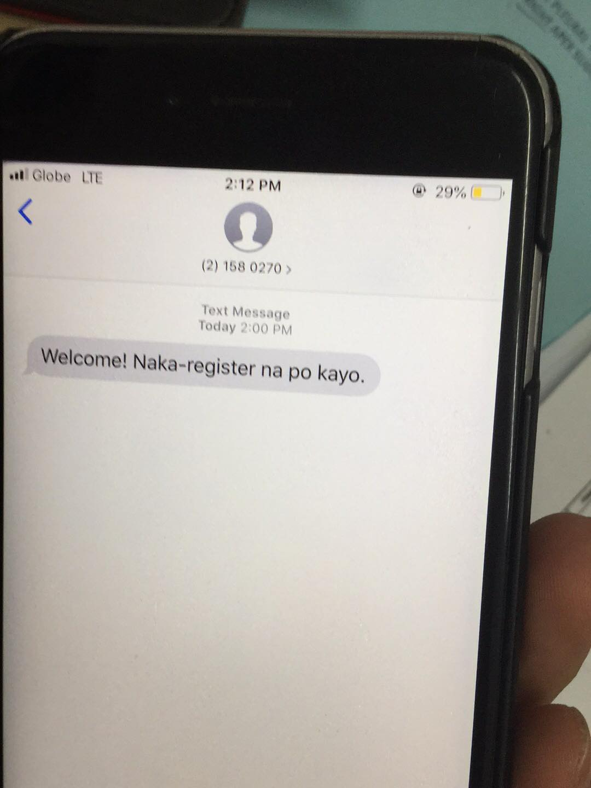
Interaction with Medication Sleeve/Label
Features of the Medication Sleeve
When the patient is registered on the platform, he/she will receive a confirmation message:
“Welcome! You are now registered on the platform.”

Slide 30
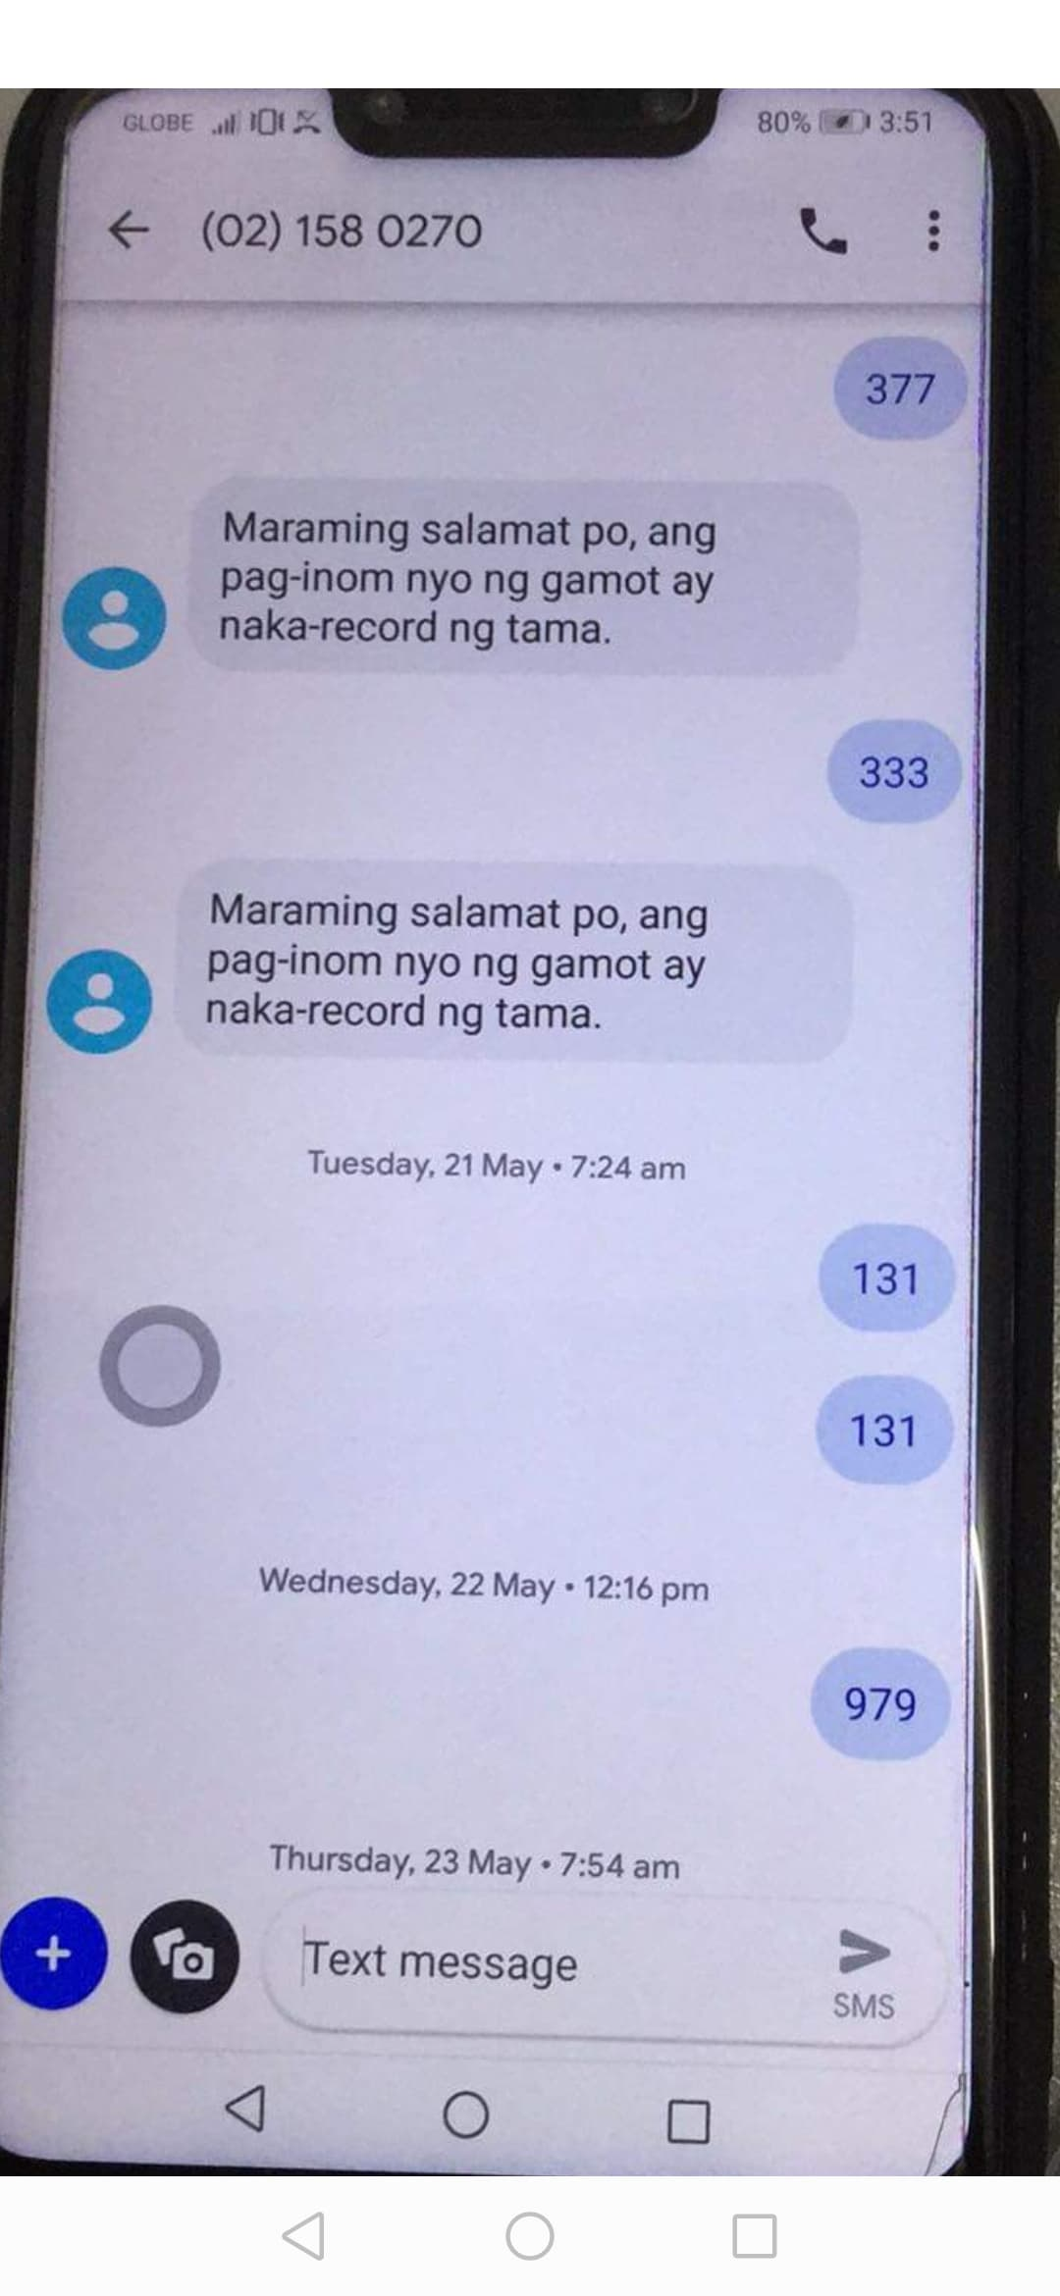
Interaction with Medication Sleeve/Label
When patients send correct 3-digit code, they will receive a confirmation message:
“Thank you very much. You have logged in your medication intake”
or
“Thank you very much. Your medicine intake has been properly recorded.”

Slide 31
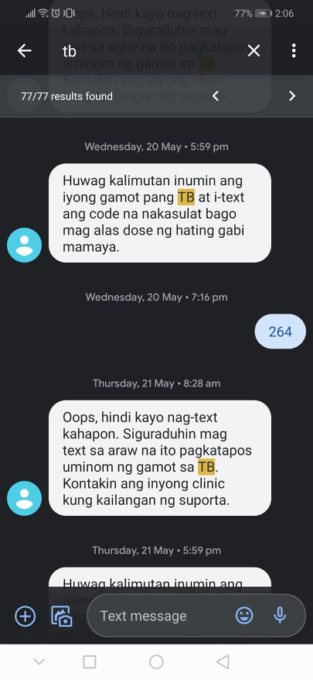
Interaction with Medication Sleeve/Label
In case of patients missed a dose, he/she will receive daily reminders from the platform:
“Don’t forget to take your TB medication and to text the code today before 12:00 midnight.”
or
“Oops, you did not log in your medication intake yesterday. Make sure you log in today after taking in your TB drugs. Contact your clinic if you need support.”

Slide 32
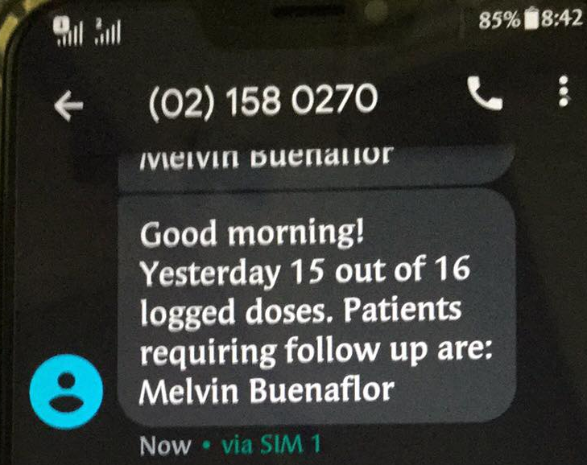
Interaction with Medication Sleeve/Label
Features of the Medication Sleeve
Health care providers are provided daily notification of patients’ adherence.
The patient interaction (sending text to toll-free phone line) immediately shows up real time on the Everwell Hub as taken doses.

Slide 33
Introduction – How the Smart Pill Box Works?

Slide 34


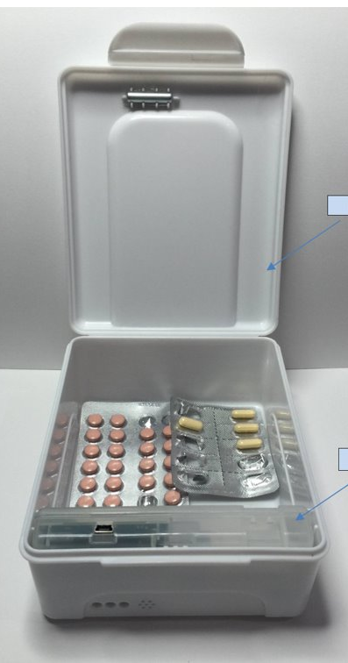
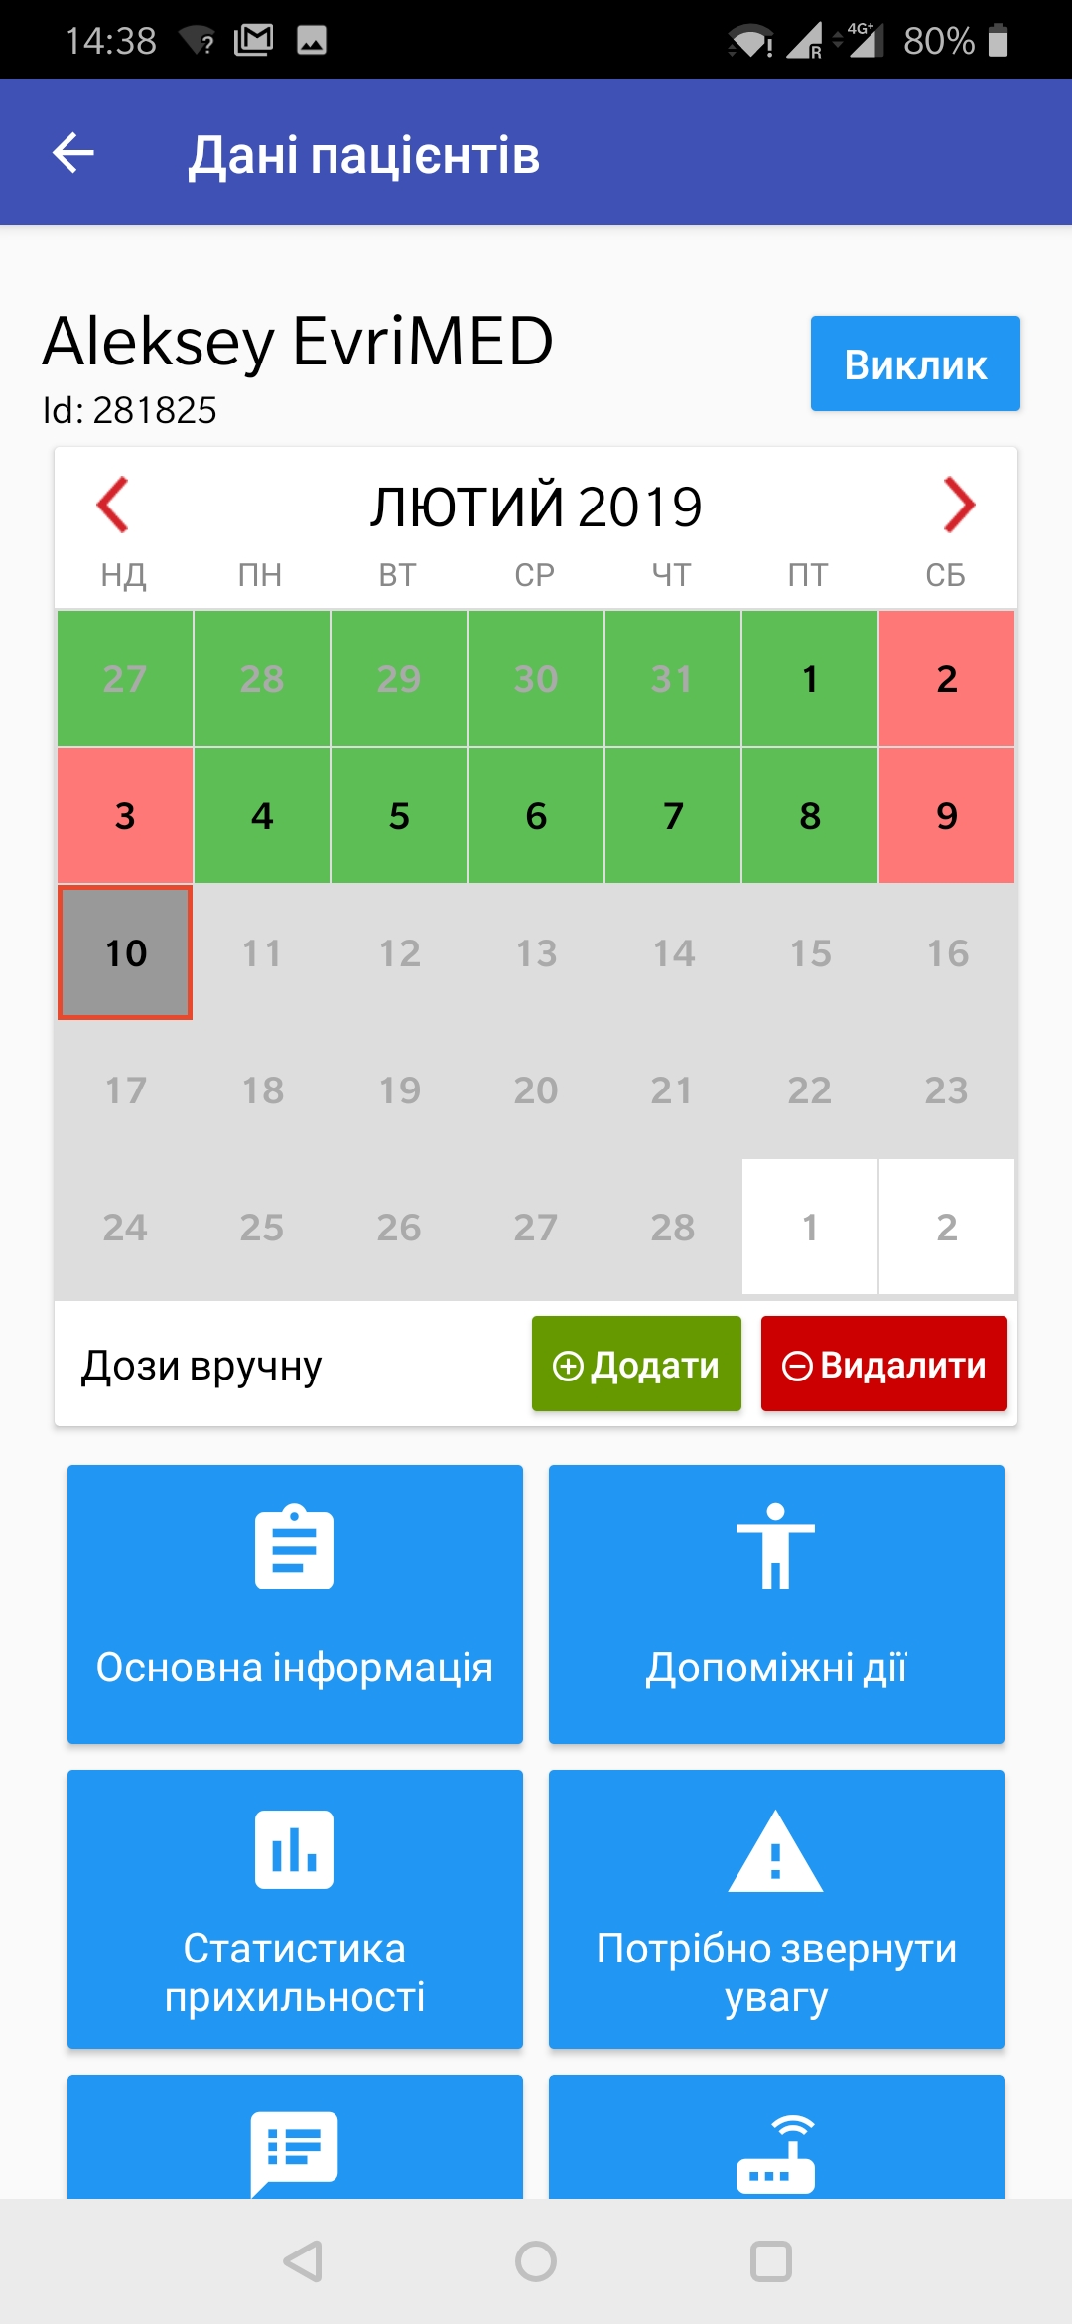
Introduction – Smart Pill Box
The smart pill box is a DAT that combines a medication container with a small electronic sensor and a SIM-enabled microprocessor to monitor dosing events.
Just opening the pill box records dosing event, with no additional effort from the patient.
Works in real-time (online) mode or in offline mode for areas / instances of low network connectivity.
SIM card sends data to platform about dosing event, total openings, device health, & battery level.

Slide 35
Introduction - Smart Pill Box
Other names for the pillbox
Smart pill box
evriMED box / device
“the box”
MERM (Medication Event Reminder Monitor)
MEMS (Medication Event Reminder System)
Notes:
These are the names that are commonly referred to when we are talking about the smart pill box technology.

Slide 36
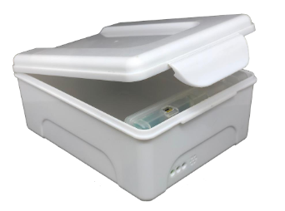
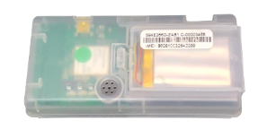
Smart Pill Box - Hardware
Plastic Box
evriMED device/module

Slide 37


Smart Pill Box - Hardware
Lithium battery & compartment
Circuit board & SIM slot

Slide 38
Basic LED Guide for Smart Pill Box
Green LED
Lid open/medication intake
Will flash once, when container is opened
3 quick flashes when quickly opened & closed
Will flash in sequence for medication alarm
Will remain on when connected via USB
Yellow LED
Refill indicator
Flashes together with green LED at time of medication
If no medication alarm is set, only yellow LED will flash
Will remain on when the pillbox is opened
Red LED
Battery low
Will flash at the time of the alarm
Will remain on when the container is opened
Will flash when the pillbox is being charged
When the pillbox is fully charged the red LED will turn off

Slide 39

Medication Instruction for the Smart Pill Box
Notes:
These are stickers that have been drafted for use in the smart pill boxes. They are designed to be attached to the inside lid of the box. These designs may need to be adapted to suit your country context, for example, translated to the local language.

Slide 40
Introduction – How Video Observed Treatment (VOT) Works?

Slide 41







Video Observed Treatment (VOT)
    Patient records drug ingestion using a mobile phone or tablet.
    Video upload process is fully automated to prevent user error or tampering.
    Health care provider views videos and records compliance data through secure web interface.

Slide 42

Overview: Adherence Platform
The Adherence Platform (Everwell Hub) is accessible in two ways:
Mobile App (Android)
Online Dashboard

Slide 43
Introduction to Everwell Adherence Platform
Also known as the “Everwell hub”/”Adherence platform”
Internet enabled web based patients adherence platform
  This is an online database that will be used to collect medication adherence and fidelity data and act as a broker for individualised care between patients and healthcare workers (HCWs).
Through the adherence platform the HCW will be able to:
  Obtain an overview of daily adherence and enrolment data
  View individual patient adherence data
  Follow-up on patients with missed doses and provide support
Requirements for accessing the Everwell platform
  Username & password
  Computer/android tablets
  Internet connectivity

Slide 44


Overview of the Adherence Platform App and Dashboard
1. Mobile App
on Android Play Store
Register a patient on the platform
Patient search by name, ID, phone number
List of patients currently on treatment
Automated reports of patients requiring follow-up
List of patients with treatment outcome assigned
Additional counselling materials (coming soon)

Slide 45

Overview of the Adherence Platform App and Dashboard
2. Adherence Platform Dashboard

Slide 46



Patient Monitoring through the Task Lists
Step 1 - Click on the ‘Patient engagement’
After selecting the ‘Task Lists’ option on the sidebar, you can choose one from the list of task lists that will appear to view the patients in that list
You can use “Task Lists” to see which patients have missed doses. These are intended to serve as action points - to either follow up with a patient, or perform an action on the dashboard
Notes:
On your left you will see different options or key elements this will be discussed in the breakout room, instead I will focus on the task list.
------------------------------------------
Aside from the Task List. HCW also receives patient summary notifications from the system.

Slide 47

Generating Reports
Notes:
Based on the level of Hierarchies:
Reports can be generated in the displayed options.
HCW can view all patients under their respective facilities;
PHOs can view all summary report under their province;
CHD3 can view all summary report for both Bulacan and Pampanga
And lastly for the NTP Central. All reports can be viewed under national level.

Slide 48

Example: Patient Detailed Reports
Notes:
This is the sample generated patient reports

Slide 49







Digital Adherence Technology: Workflow - Summary
Patient’s sputum is sent for testing
Medical evaluation for evidence of TB
Patient visits Facility with symptoms of TB
Cough, Fever, Night sweats, Weight loss
Continuous monitoring and follow up by staff
Patient registered on Everwell platform and counseled on adherence
Patient identified positive for TB

Slide 50
Thank you!

