Slide 1
Adherence Platform Customization
A workshop presentation to customize the adherence platform (web dashboard and mobile app) with stakeholders.
www.tbdigitaladherence.org

Slide 2
Download Everwell Hub App from the Google (Android) PlayStore
Username: {provided by Everwell}
Password: {provided by Everwell}
User Design Workshop – App
1. Registering a patient
What fields need to be deleted/added/change? (variables/options)
Things that you like/don’t like about the process or screens/buttons?
How do you see this fitting into your current patient registration/counseling process?
2. Patient calendar:
Ethiopian and/or Gregorian calendar. How to show the calendar?
Add a manual dose. Is the process clear, need for adjustments?
Things that you like/don’t like about the calendar overview?
3. Patient details:
What is most important for you to know for proper patient follow-up & support? Is this currently included in the app?
What details need to deleted/added/change? (blue buttons below calendar)
MEMS overview: Is this information relevant? Any adjustment needed?

Slide 3
Consolidation of Findings: App Design
Register a patient | A B C
Patient calendar | A B C
Patient details | A B C
Any other suggestions

Slide 4
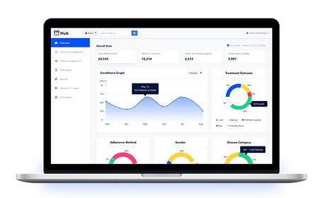
Web browser: https://hub.everwell.org/
Username: {provided by Everwell}
Password: {provided by Everwell}
User Design Workshop – Web dashboard
1. Overview: A. Are these visualizations showing valuable (actionable) information? B. What would be better displayed here? C. What “snapshot” is most important to see? (# current patients, # total patients, % adherence of clinic…)
2. Prioritization: A. How should we define when a patient is “high priority”? (What do you currently consider to be a “high priority?”) Is it based on # days of nonadherence, or a specific moment during treatment?
3. Patient calendar: A. What patient information is most important to display in these columns? B. What fields would you like to sort by? What should be the default view?
4. Adding notes/tags:
A. What is the most common information you currently access/look up about your patients? B. What kinds of notes/comments/tags would you like to add about your patients? (ADRs, coinfection, manual dose, etc.) C. What is most important for you to know for proper patient follow-up & support? 5. General: Comments/feedback about the way the dashboard looks? Functionality? Things you like/don’t like? Can the dashboard be in English?

Slide 5
Consolidation of Findings: Dashboard design
 | Comments
Overview | A B C
Prioritizations | A
Patient calendar | A B
Notes/tags | A B C
General

